Slide 1

ASSIGNMENT 1
Algorithm Lab (CS2271)

Slide 2
Introduction
This Report is Made By:
Abhiroop Mukherjee (510519109)
Hritick Sharma (510519114)
Sayak Rana (510519108)
The Source codes for all the Assignments can be found here: https://github.com/Abhiroop25902/CS-2271-Algo-Lab

Slide 3

Question 1A
Construct large data sets taking random numbers from uniform distribution (UD)…

Slide 4

Procedure
The inbuilt C function rand()generates random numbers distributed uniformly.
Using rand() we generated ${10}^{6}$ uniformly distributed random numbers between 0 to 100 and stored it in uniform_distribution.csv which will act as uniformly distributed dataset for further works.
We also plotted a histogram of the dataset to make sure that the dataset generation worked well or not…

Slide 5
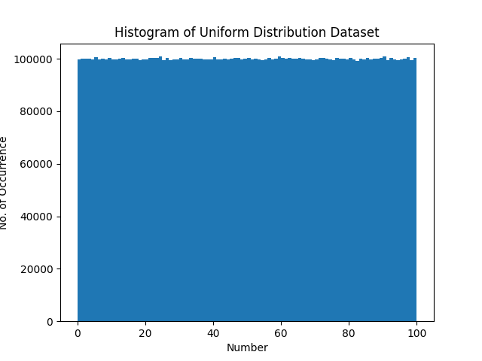
Observation
We see from the histogram of the dataset that every numbers has almost equal number of occurrence, which shows that the numbers are uniformly distributed.

Slide 6
Question 1B
Construct large data sets taking random numbers from normal distribution (ND)…

Slide 7

Procedure
.
The idea is that sum of $m$ uniform randomly generated number can’t be too high and can’t be too low, the sum will be more concentrated towards the mid, which resembles Normal Distribution.
So we randomly generated 10 uniformly distributed numbers between 0 and 10, took their sum and saved it to the dataset.
These value range was selected so as to make the min. sum 0 and max. sum 100, i.e. “Normally” Distributed dataset with values between 0-100.
We did the same procedure ${10}^{6}$ times to generate a dataset normal_distribution.csv consisting of ${10}^{6}$ normally distributed numbers.
Then we also plotted it’s histogram to make sure if the dataset actually follows Normal Distribution or not…

Slide 8
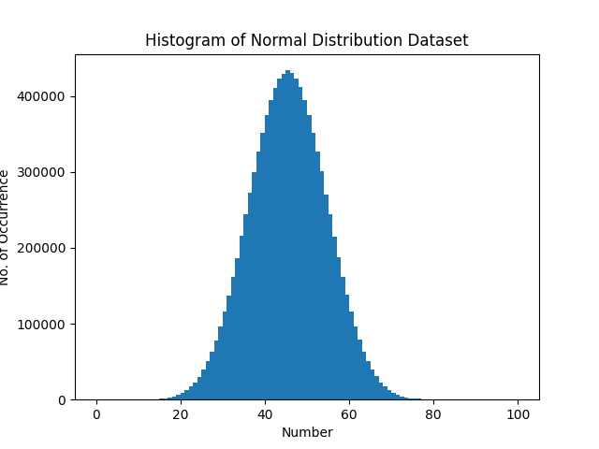
Observation
Here we see the recognizing shape of “bell” curve of Normally Distributed Random variable.
This shows that the dataset values are uniformly distributed

Slide 9
Question 2A
Implement Merge Sort (MS) and check for correctness.

Slide 10

What is Merge Sort
The Merge sort is a “Divide and Conquer” Algorithm which works as follows:
Divide n-element sequence into n/2 elements in two subsequences. [$O(1)$, divides into two parts]
CONQUER: sort the two subsequences recursively.
COMBINE: MERGE the two subsequences. [$O(n)$]
This method gives the following recurrence relation:
$$T\left(n\right)=2 T\left(\frac{n}{2}\right)+O(n)$$

Slide 11
Merge Sort Algorithm
MergeSort(arr[ ], l, r){
If (r > l) {
// Find the middle point to divide the array into two halves
middle m = (l+r)/2 ;
// Call Merge Sort for first half
MergeSort(arr, l, m) ;
// Call merge Sort for second half
MergeSort(arr, m+1, r) ;
// Merge the two halves sorted
Merge(arr, l, m, r) ;
}
}

Slide 12
Question 2B
Implement Quick Sort (QS) and check for correctness.

Slide 13

What is Quick Sort
Quicksort is a Divide and Conquer algorithm. It picks an element as pivot and partitions the given array around the picked pivot. There are many different versions of Quicksort that pick pivot in different ways.
Always pick first element as pivot. (implemented below)
Always pick last element as pivot
Pick a random element as pivot.
Pick median as pivot.
The key process in Quicksort is partition(). Target of partitions is, given an array and an element $x$ of array as pivot, put $x$ at its correct position in sorted array and put all smaller elements (smaller than $x$) before $x$, and put all greater elements (greater than $x$) after $x$. All this should be done in linear time.

Slide 14
Quick Sort Algorithm
PARTITION(A,p,r){
x=A[p] ;
i = p-1; j = r+1 ;
while (true){
repeat j=j-1 until A[j}<=x;
repeat i=i+1 until A[i]>=x;
}
if( i < j )
exchange( A[i] , A[j] );
else
return (j);
}
QUICK_SORT(A,p,r) {
if (p<r) {
q=PARTITION(A,p,r) ;
QUICK_SORT(A,p,q) ;
QUICK_SORT(A,q+1,r) ;
}
}

Slide 15
Question 3
Count the operations performed, like comparisons and swaps with problem size increasing in powers of 2, for both MS and QS with both UD and ND as input data.

Slide 16

Procedure
We did both sorting algorithm for different array size, which starts from 2 and increments in powers of 2 till our system gives Error due to Huge Size
We were able to record observation from array size $2$ to array size $2^{20}$
For each array size $n$, we sorted 100 different arrays of size $n$, taken from the datasets made in Question 1. Recorded the number of comparison and Time Taken per sort, then took their mean.
We then Plotted the following graphs for both datasets
$comparision ratio= \frac{avg_comp}{nlgn}$ vs $n$
$time ratio= \frac{avg_time_taken}{nlgn}$ vs $n$

Slide 17
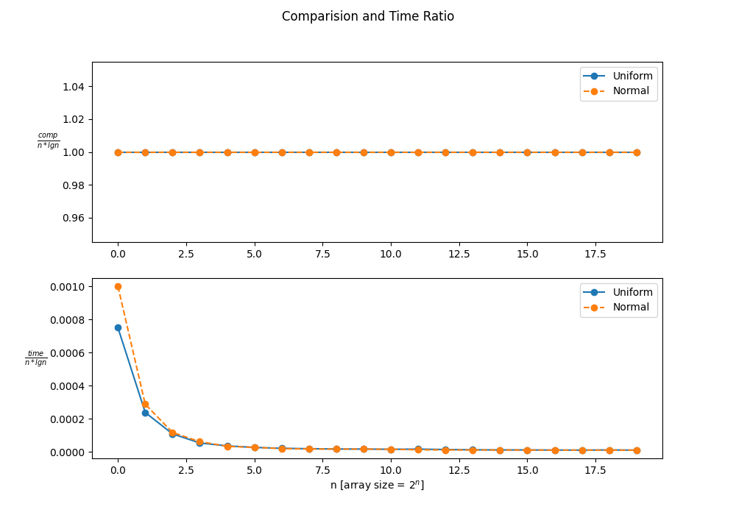

Observation for Merge sort
Following Inference can be made by the Observed Graph:
From the graphs, we see that both time ratio and comparison ratio converges to constant as n goes to very big sizes, it means that Merge Sort Algorithm has $O(nlgn)$ complexity

Slide 18
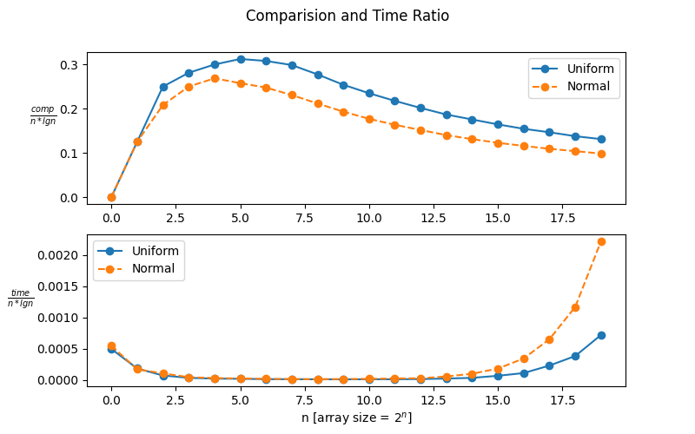
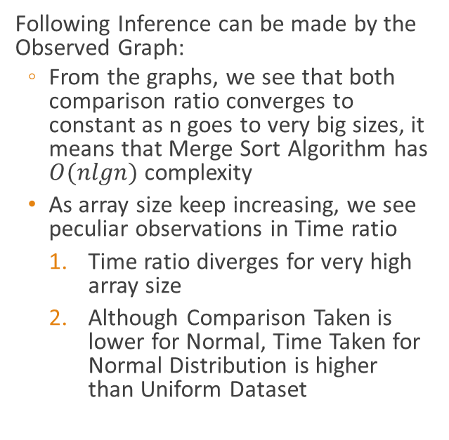
Observation for Quicksort
Following Inference can be made by the Observed Graph:
From the graphs, we see that both comparison ratio converges to constant as n goes to very big sizes, it means that Merge Sort Algorithm has $O(nlgn)$ complexity
As array size keep increasing, we see peculiar observations in Time ratio
Time ratio diverges for very high array size
Although Comparison Taken is lower for Normal, Time Taken for Normal Distribution is higher than Uniform Dataset

Slide 19
Comparison Analysis Quicksort
For Normal Distribution, there is higher chance for a pivot to be near median, which makes more chances for 1:1 Partitions.
And the more 1:1 partition we get, more the less sub partitions will be formed, resulting in less no. of comparisons.
Due to this property, we see a smaller number of comparisons for normal, when compared to uniform distribution

Slide 20
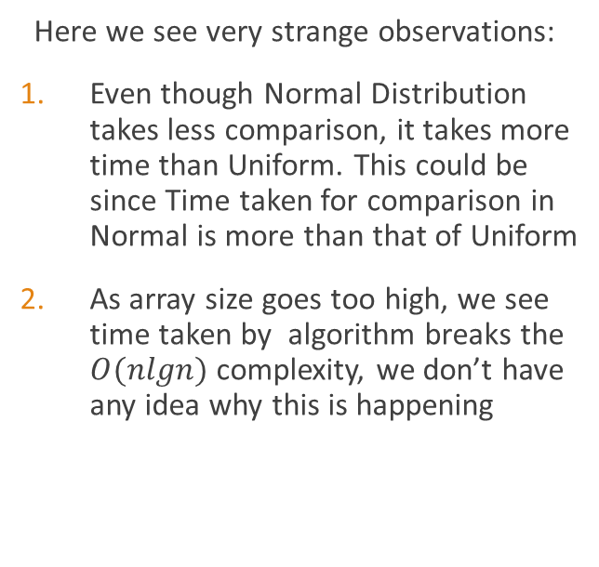
Time Analysis Quicksort
Here we see very strange observations:
Even though Normal Distribution takes less comparison, it takes more time than Uniform. This could be since Time taken for comparison in Normal is more than that of Uniform
As array size goes too high, we see time taken by algorithm breaks the $O(nlgn)$ complexity, we don’t have any idea why this is happening

Slide 21
Question 4
Experiment with randomized Quick Sort with both Uniform And Normal Distribution as input data to arrive at the average complexity (count of operations performed) with both input datasets.

Slide 22

What is a Randomized Algorithm?
An algorithm that uses random numbers to decide what to do next anywhere in its logic is called a Randomized Algorithm. For example, in Randomized Quick Sort, we use a random number to pick the next pivot (or we randomly shuffle the array). And in Karger’s algorithm, we randomly pick an edge.

Slide 23
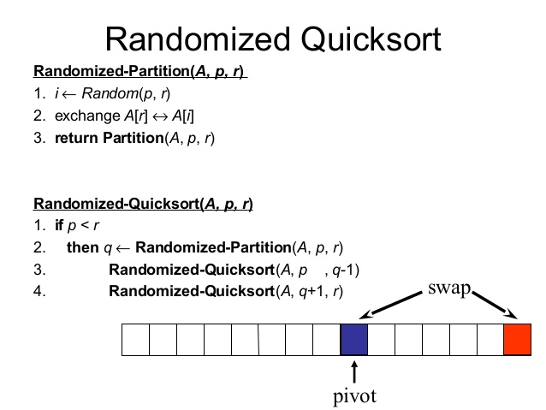
Randomized Quicksort Algorithm

Slide 24
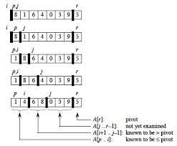
Working of Randomized Quicksort

Slide 25


Time Complexity of RQ..
Randomized quicksort has expected time complexity as $O(nlgn)$,but worst-case time complexity remains same. In worst case the randomized function can pick the index of corner element every time.

Slide 26

Procedure
We did Randomized Quicksort for different array size, which starts from 2 and increments in powers of 2 till our system gives Error due to Huge Size
We were able to record observation from array size $2$ to array size $2^{20}$
For each array size $n$, we sorted 50 different arrays of size $n$, taken from the datasets made in Question 1. Recorded the number of comparison and Time Taken per sort, then took their mean.
We then Plotted the following graphs for both datasets
$comparision ratio= \frac{avg_comp}{nlgn}$ vs $n$
$time ratio= \frac{avg_time_taken}{nlgn}$ vs $n$
We also plotted the usual Quick Sort Observations for comparisons too.

Slide 27
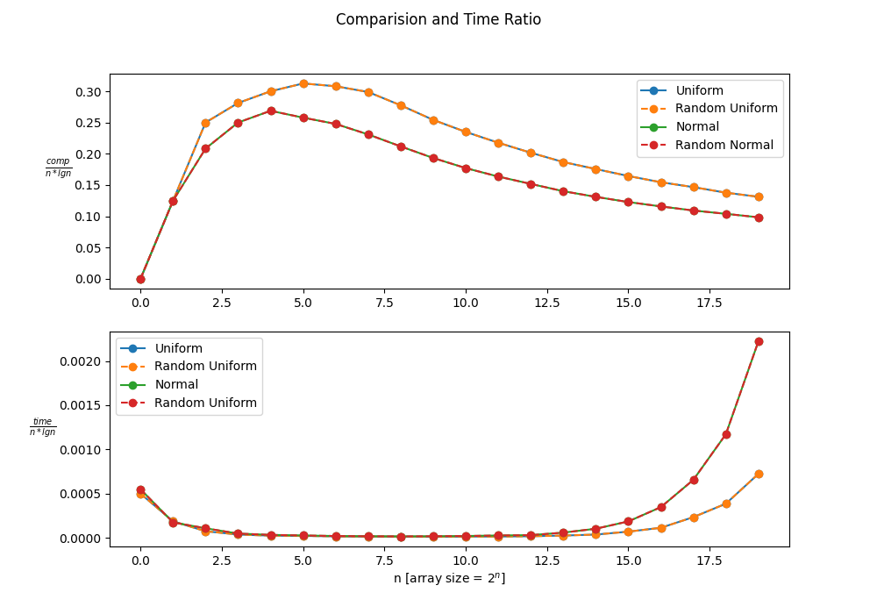

Observation
Following Inference can be made by the Observed Graph:
As we did 50 sorts per n, and took its mean, the time complexity comes out to be same as Non-Random Quick Sort, i.e., $O(nlgn)$
As array size keep increasing, we see similar observation, i.e., the comparison ratio and time ratio converges.
The Divergence of Time ratio for Big array size might be linked to low system RAM. which asks for more Secondary Memory Calls

Slide 28
Problem and Solution
As we can see in the graphs, the observation between Randomized and Non-Randomized Algorithms are near same as we averaged the observation
Solution: We Test the Randomized Quicksort with different deliberately made partition of size other than halves (as randomized tends to go towards 1:1 partition)

Slide 29

How do we make custom size partitions
As we need to make our own size partitions, we need a way to make custom sized partitions
For this we used randomized_select() algorithm
This function uses same randomized_partition() to find $k^{th}$ smallest element of array without sorting the array and does the same in $O\left(n\right)$average time complexity
We can then use the output of randomized_select() as pivot to make custom size partitions

Slide 30

Procedure
We did Randomized Quicksort for different array sizes as before, as well as different partition sizes
For each array size $n$ and partition size, we sorted 10 different arrays of size $n$, taken from the datasets made in Question 1. Recorded the number of comparison and Time Taken per sort, then took their mean.
We then Plotted the following graphs for both datasets
$comparision ratio=avg_comp$ vs $n$
$time ratio=avg_time_taken$ vs $n$
Notation regarding the Upcoming Observation
Fraction $\frac{1}{α}$ means that partitions are made as follows
One Partition has size $α$
The other Partition has size $(arr_size−α)$
We recorded partitions size so as to make the partitions as skew as possible

Slide 31
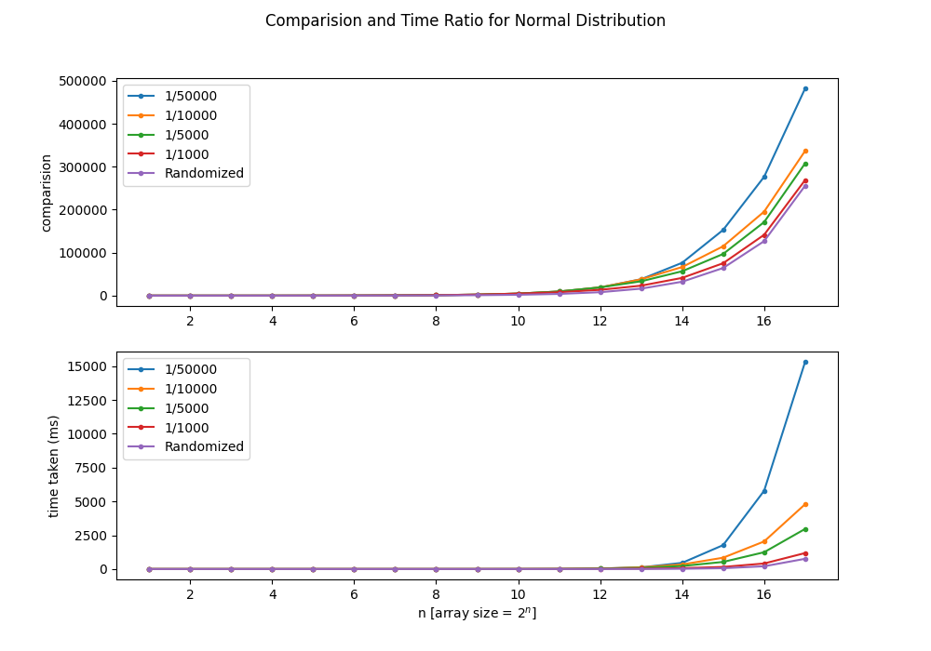
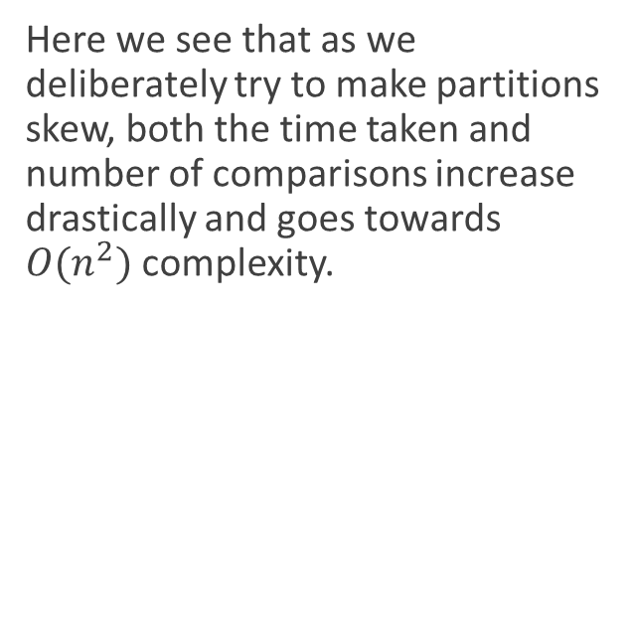
Normal Observation
Here we see that as we deliberately try to make partitions skew, both the time taken and number of comparisons increase drastically and goes towards $O(n^{2})$ complexity.

Slide 32
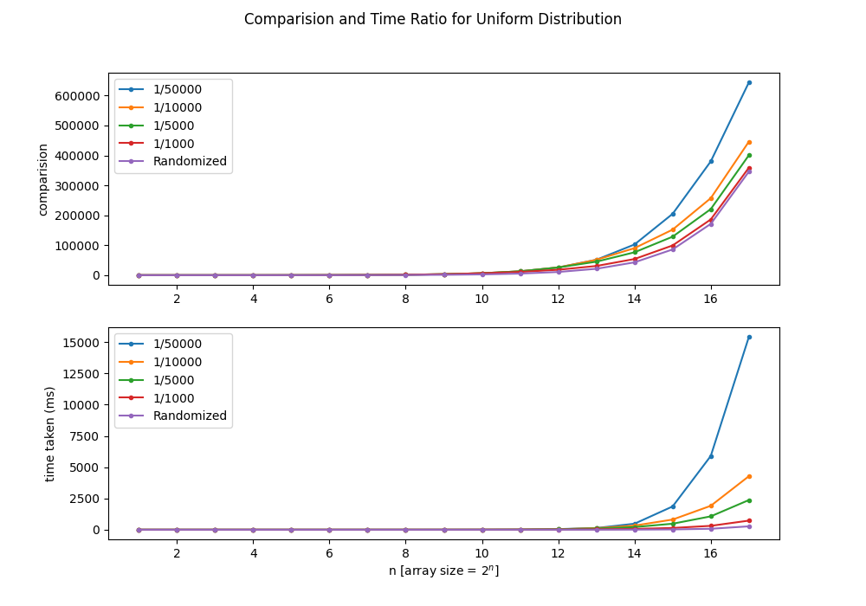
Uniform Observation
Here we see same observations as that of Normal Distribution

Slide 33
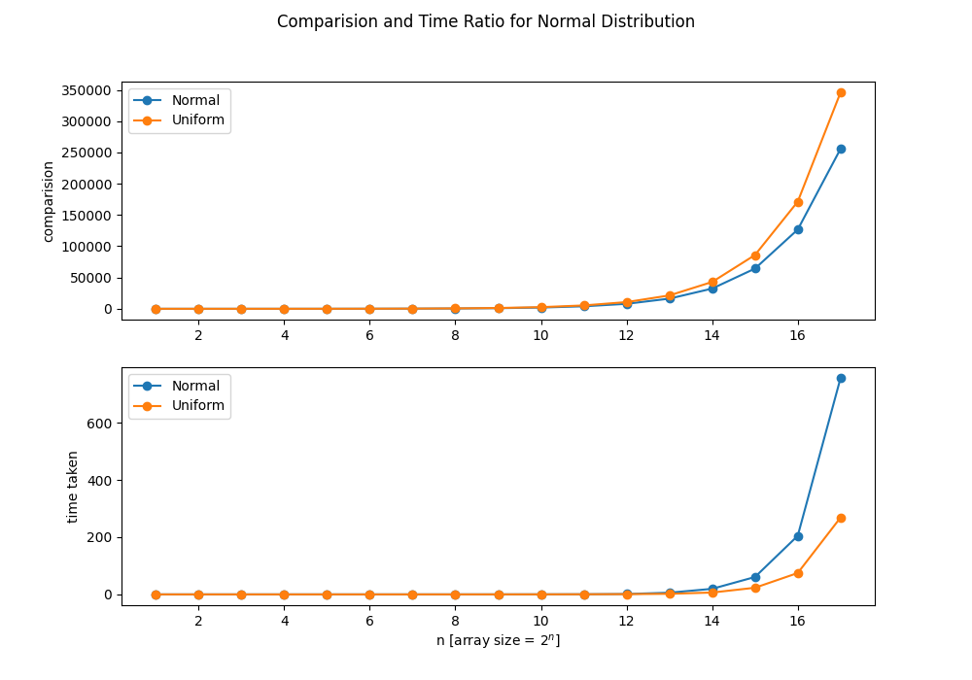
Normal vs Uniform
Here we see same observations as the previous quick sort observations, i.e. Comparisons of Normal is lower than Uniform as in Normal Distribution, most of the elements are concentrated towards median.
And same as before, Time taken by Normal is more than Uniform although its Comparison are less than Uniform

Slide 34
Question 5
Now normalize both the datasets in the range from 0 to 1 and implement bucket sort (BS) algorithm and check for correctness

Slide 35

Procedure
As All Values in our dataset was between 0 and 100, we took each value one by one, divided each value by 100, and then saved it to a different files.
The no. of data in the dataset was kept same, i.e. ${10}^{6}$
We Then Plotted the histogram of the datasets to make sure the conversion was conversion was correct.

Slide 36
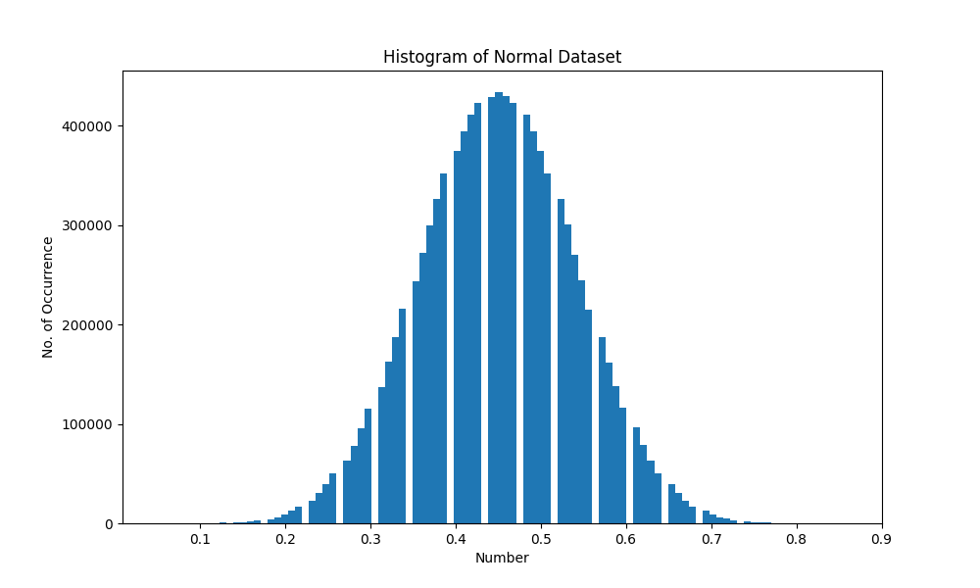
Histogram for Normal Dataset
As Expected, the histogram has the “bell” curve and max value of the dataset goes to 1.
Hence, our conversion was successful

Slide 37
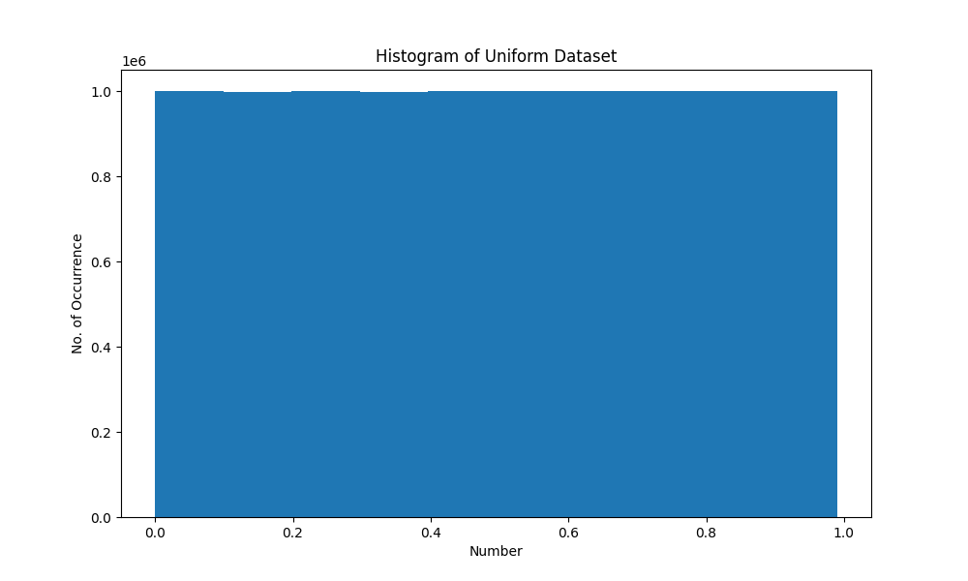
Histogram for Uniform Dataset
As Expected, the histogram has the same number of occurrences for every numbers range and max value of the dataset goes to 1.
Hence, our conversion was successful

Slide 38
Question 6
Experiment with Bucket sort to arrive at its average complexity for both Uniform and Normal datasets and infer.

Slide 39

What is Bucket Sort
Bucket sort, or bin sort, is a sorting algorithm that works by distributing the elements of an array into several buckets. Each bucket is then sorted individually, either using a different sorting algorithm, or by recursively applying the bucket sorting algorithm. It is a distribution sort, a generalization of pigeonhole sort, and is a cousin of radix sort in the most-to-least significant digit flavor. Bucket sort can be implemented with comparisons and therefore can also be considered a comparison sort algorithm. The computational complexity depends on the algorithm used to sort each bucket, the number of buckets to use, and whether the input is uniformly distributed.

Slide 40
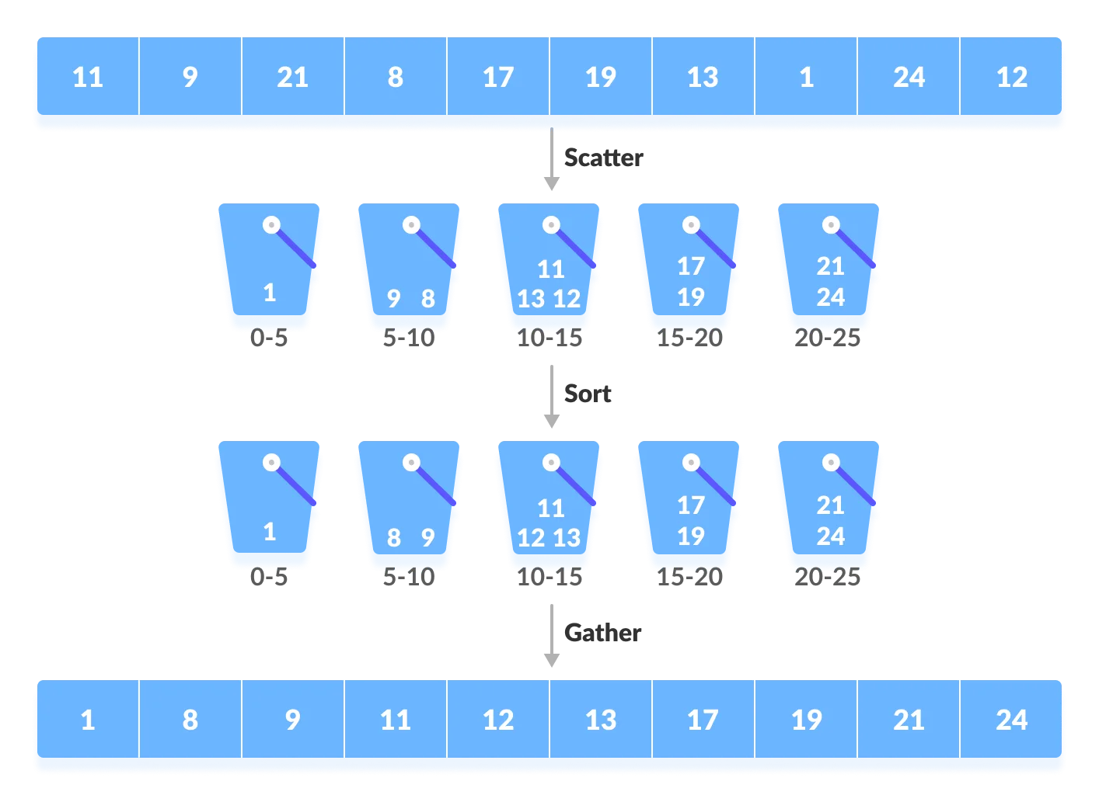
Bucket sort algorithm….

Slide 41
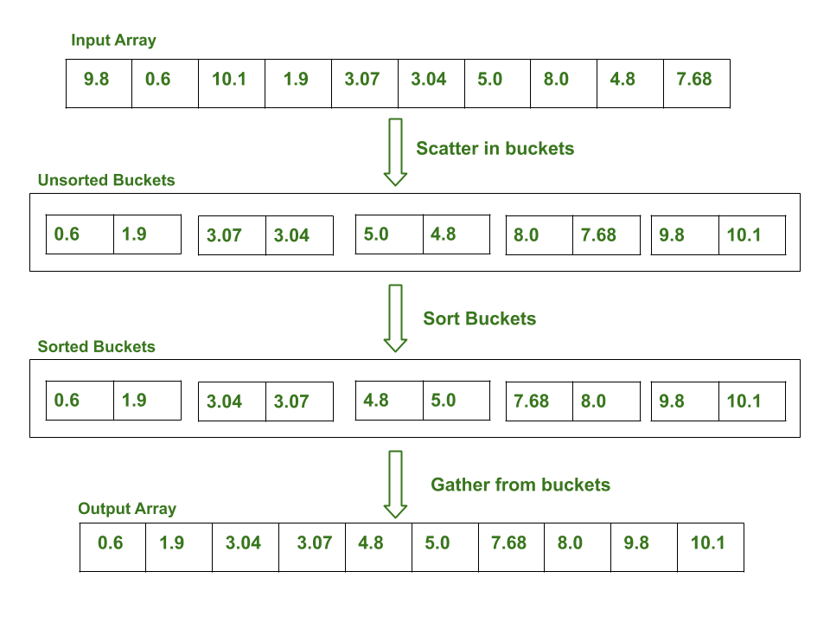
Bucket sort implementation on an array

Slide 42
The complexity of the Bucket Sort Technique
Time Complexity: $O(n+k)$ for best case and average case and $O(n^{2})$for the worst case.
Time Complexity: 𝑂(𝑛+𝑘) for best case and average case and 𝑂(𝑛^2)for the worst case.
Space Complexity: $O\left(nk\right)$ for worst case
Space Complexity: 𝑂(𝑛𝑘) for worst case

Slide 43

Procedure
We did Bucket Sort for different array size, which starts from 2 and increments in powers of 2 till $2^{15}$
For each array size $n$, we sorted 10 different arrays of size $n$, taken from the datasets made in Question 1. Recorded the number of comparison and Time Taken per sort, then took their mean.
We then Plotted the following graph
$time ratio= \frac{avg_time_taken}{n}$ vs $n$

Slide 44
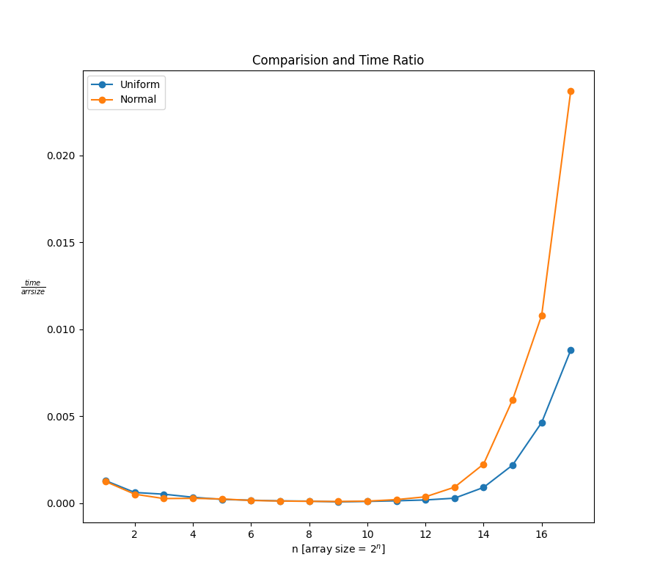
Observation
Here we see that time taken by the Normal Distribution is way more than that of Uniform Distribution
This is happening because in Normal Distribution more elements are concentrated around mean, due to which a lot of elements gets inserted on a same bin, and sorting that large linked list is very costly with respect to time.

Slide 45
Question 7
Implement the worst case linear median selection algorithm by taking the median of medians (MoM) as the pivotal element and check for correctness.

Slide 46


What is Median Of Median (MoM)
The Median of Medians is an approximate (median) selection algorithm, frequently used to supply a good pivot for an exact selection algorithm, mainly the quicksort, that selects the $k^{th}$ largest element of an initially unsorted array.
Median of medians finds an approximate median in linear time only, which is limited but an additional overhead for quicksort.
When this approximate median is used as an improved pivot, the worst-case complexity of quicksort reduces significantly from $O\left(n^{2}\right)$ to $O\left(nlgn\right)$ , which is also the asymptotically optimal worst-case complexity of any sorting algorithm.

Slide 47
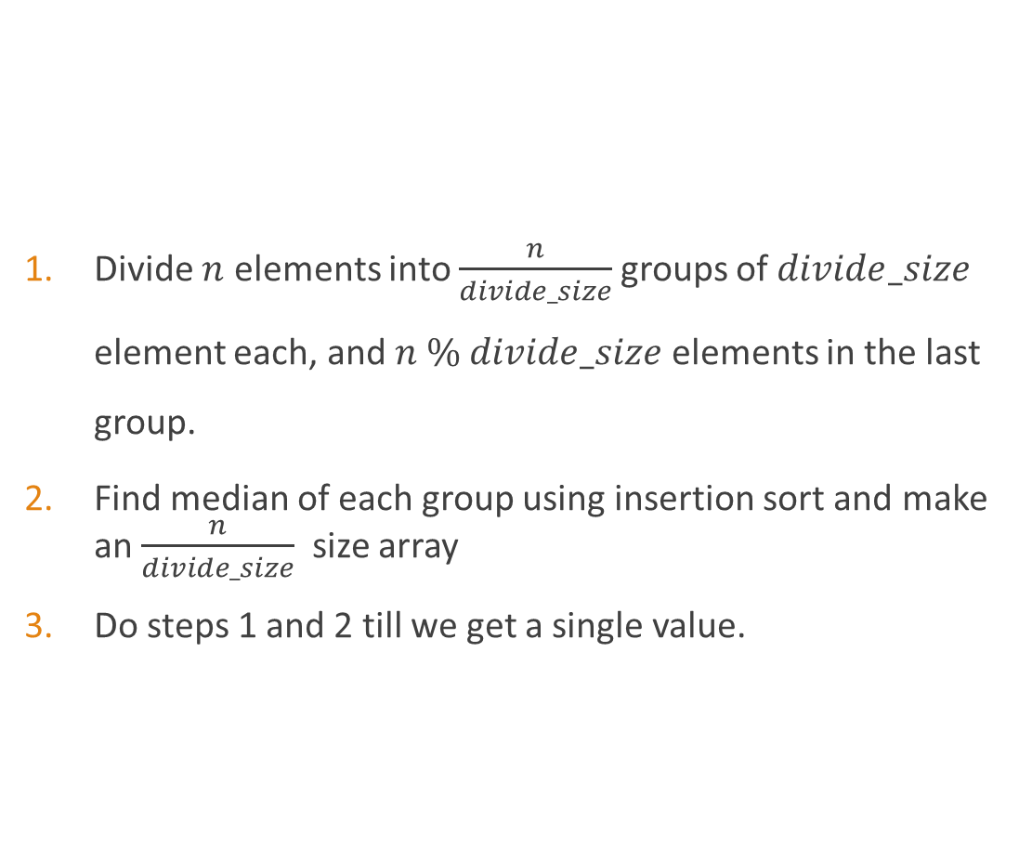
Median Of Median Algorithm
Divide $n$ elements into $\frac{n}{divide_size}$groups of $divide_size$ element each, and $n \% divide_size$ elements in the last group.
Find median of each group using insertion sort and make an $\frac{n}{divide_size}$ size array
Do steps 1 and 2 till we get a single value.

Slide 48
The complexity of the Median Of Median
Time Complexity: $O(n)$ for worst case
Time Complexity: 𝑂(𝑛) for worst case

Slide 49
Question 8
Take different sizes for each trivial partition (3/5/7 ...) and see how the time taken is changing.

Slide 50

Procedure
We did Median of Median for fixed array size ${10}^{5}$, but varied the divide size in $\{3,5,7,9,…,2003\}$
For each divide size, we computed MoM for 10 different arrays, generated randomly (Uniform) with number in range $(0,100)$. Recorded Time Taken per Pass, then took their mean.
We then Plotted the graph of time vs divide size

Slide 51
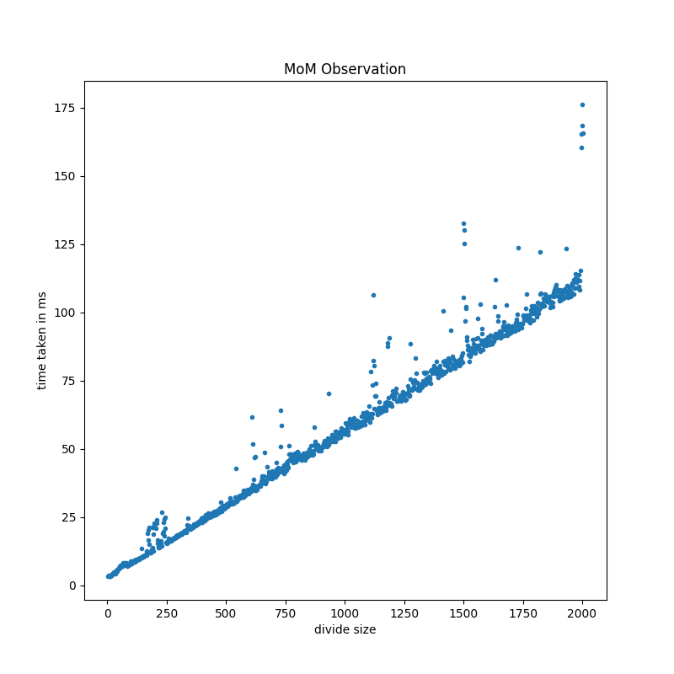
Observation
From the graph we can infer that time complexity is Linear with Divide Size

Slide 52
Question 9
Perform experiments by rearranging the elements of the datasets (both UD and ND) and comment on the partition or split obtained using the pivotal element chosen as MoM.

Slide 53

Procedure
We did Median of Median for divide size 5, but varied the size of array from 100 to ${10}^{5}$, with increments of 100
For each array size, we computed MoM for 10 different arrays, chosen randomly form the datasets generated at question 1. used Partition() with MoM as pivot element, and recorded the output position, then took their mean.
We then Plotted the graph of $\frac{partition}{arr_size}$ vs $arr_size$ for both datasets.

Slide 54
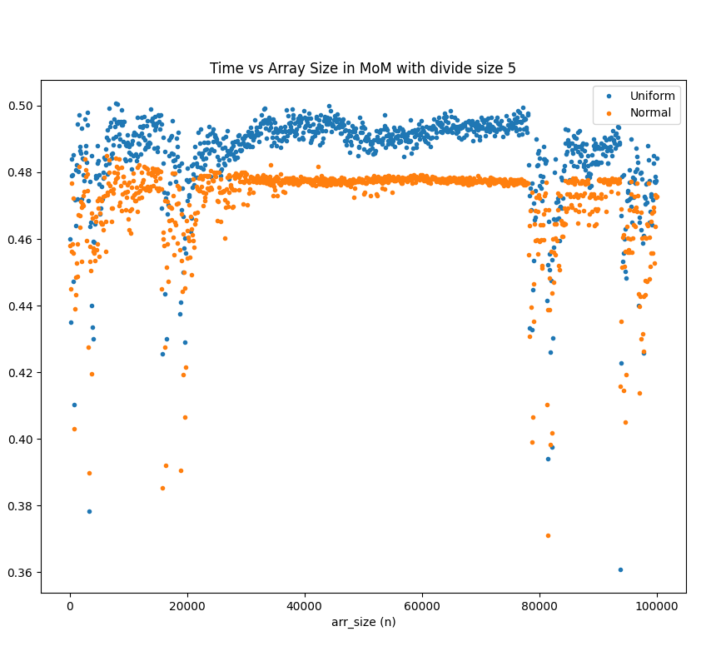

Observation
As we can see the $\frac{partition}{arr_size}$ varies in range $\left(0.36,0.5\right)$ with majority of cases around 0.5.
This shows that what MoM finds is very close to actual median, and hence MoM can mostly guarantee a good pivot of Quicksort Algorithm.

Slide 55
Peculiar Observation
We observed two peculiar observations
There is a strange dip in the ratio in some places.
We also see a stark difference between Uniform and Normal Distribution

Slide 56
Uniform vs Normal
The Stark difference between Uniform and Normal could be because MoM doesn’t give exact median but approximates the median. And as Normal Distribution has more elements concentrated in the median; we will have decreased accuracy in case of normal
To test this hypothesis, we did the same experiment with divide size 3 and 7
If our hypothesis comes out to be true, the difference between uniform and normal should increase for divide size 7 and should decrease for divide size 3.

Slide 57
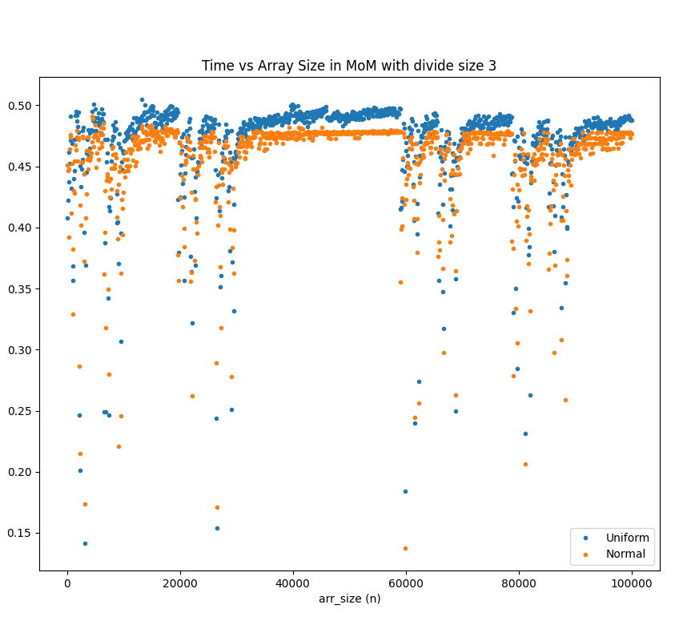
Divide Size 3
Here we see that if we decrease the divide size to 3, the difference between Uniform and Normal Dataset decreases quite a lot.
This is happening as the region of approx. median has decreased, giving better accuracy for Normal Distribution.

Slide 58
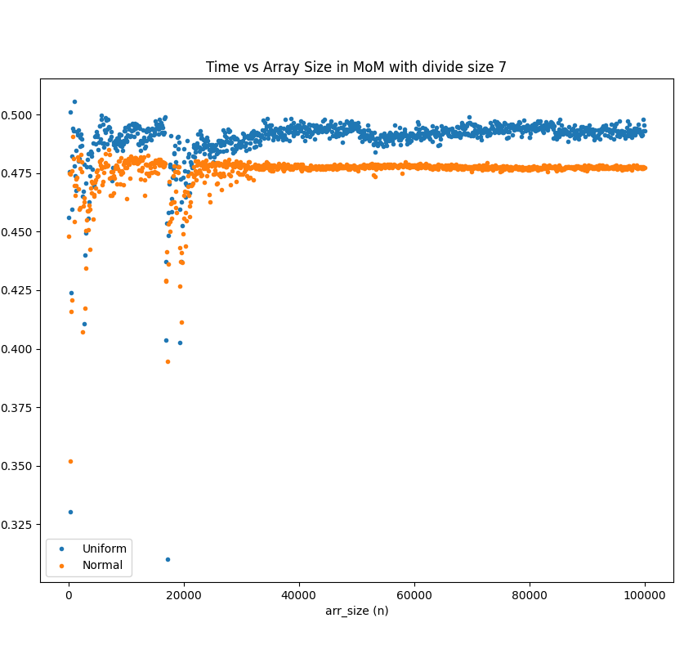
Divide Size 7
Here we see that the difference between the Uniform and Normal is like divide size 5, but the drop region has gone away.
By this observation, we could say that we might getting the “drops” as out divide size is very small and increasing the divide size might potentially remove the “drops”.

Slide 59
The End

